Slide 1
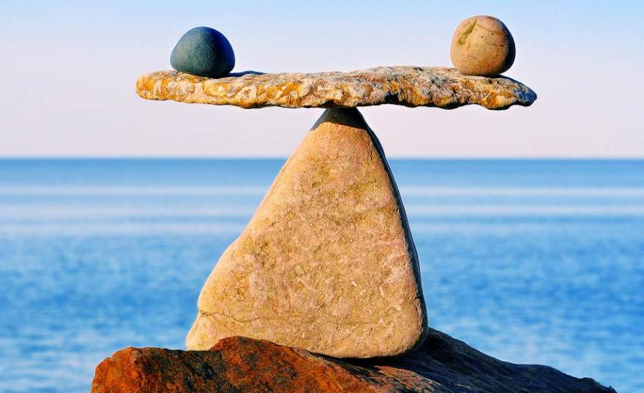
The balance between circular economy & zero-pollution ambitions
> FEAD event: Combining CE & ZP
1st June 2021
Example from WEEE
REMONDIS Electrorecycling GmbH
Sebastian Schormann
Head of Sales ear / b2c

Slide 2
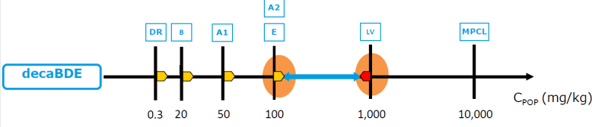
Practical example: POP discussions about limit values for PBDE´s (e.g. decaBDE) in recycling plastics
Based on discussions which started in 2017 there was already a progress to set a new limit value for decaBDE (PBDE) in recycling plastics:
  Discussed limit value decaBDE: 10 mg / kg (also for recycling plastics which means no more recycling possible)
  Result: 500 mg/kg (for unintentional trace contaminants in articles →Recycling plastics)
Where did the limit of 10 come from?
  → In the beginning it was a recommandation from a supplier for measuring devices and it was the calibration limit of his devices which only works for new plastics – placed by a former member of the EU Parliament
PBDE: Polybrominated diphenyl ethers

Slide 3
What is the influence of limit value? Before & …
+
-
Situation with a limit of 500 mg / kg

Slide 4
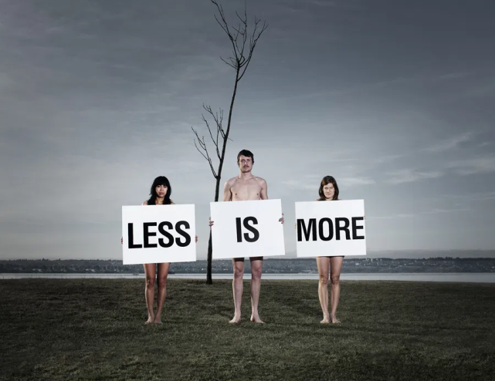
What is the influence of limit value? … after
Talking about new limits
(10, 20, 50, 100 mg / kg)
+
-
+
?
-

Slide 5
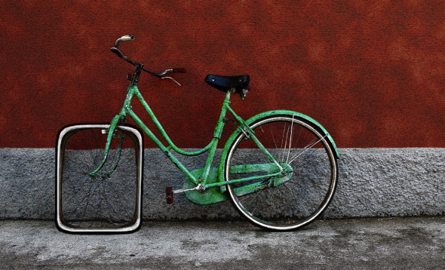
What is the result of the discussions?
There was no specific basis for the proposed and planed limit value of 50 mg / kg
The total recycling of weee plastics was threatened (impossible to achieve that value)
there was not even a measuring process in place to evaluate
Stop of investments in new recycling activities
Achievment of the weee recycling target is influenced by that limit value
→ strict values will lead to failure

Slide 6
What would be the result of strict limit values?
Strict values would stop recycling of weee plastics
In principle there is no doubt about the use of the POP regulation to separate those substances
But there were big discussions about the environmental impacts:
  What is the real danger as long as the substances are in a chemical compound of plastics and are used in a suitable product?
  What is the enviromental impact to incinerate that plastcis which will also cause additional emissions for the production of new plastics?

Slide 7

What do we want?
We all want both
  A sustainable society (circular economy)
  with a healthy environment (zero pollution)
→We need to balance!
circular
Economy (CE)
zero pollution (ZP)

Slide 8
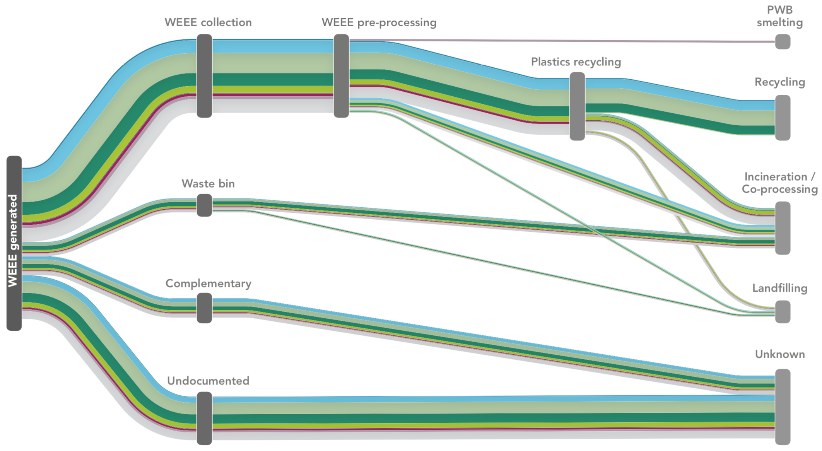
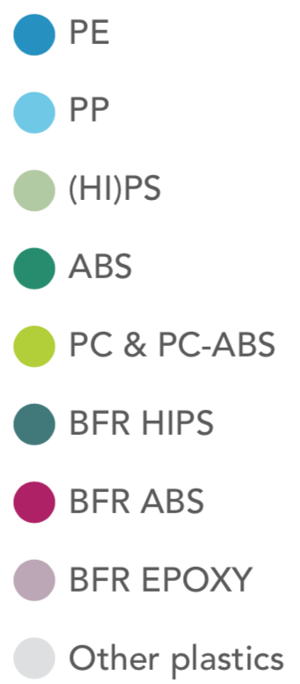
WEEE Plastics Mass Flows (EU28+2, 2020)
22% of
all WEEE
plastics
One of the biggest problems is the fact that only a very limited part ends up in suitable recycling facilities.
Source: SOFIES Study

Slide 9
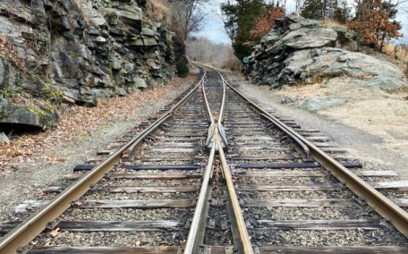
For the future
There should be more interaction between both sides: CE & ZP
Only a reliable legal framework will lead to investments in more recycling technologies
which includes a suitable lead time for new requirements
Also producer need a reliable basis otherwise there won´t be any markets for the plastics
There should be a financial benefit for producer to use recycling material (e.g. based on saved emissions)
Zero pollution starts with eco design!
Stricter limits should be always based on scientific findings which should also include an impact assessment

Slide 10
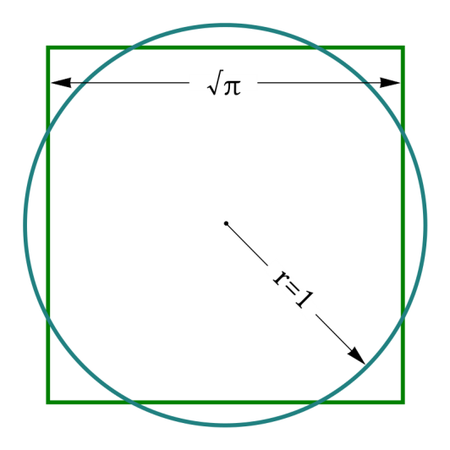
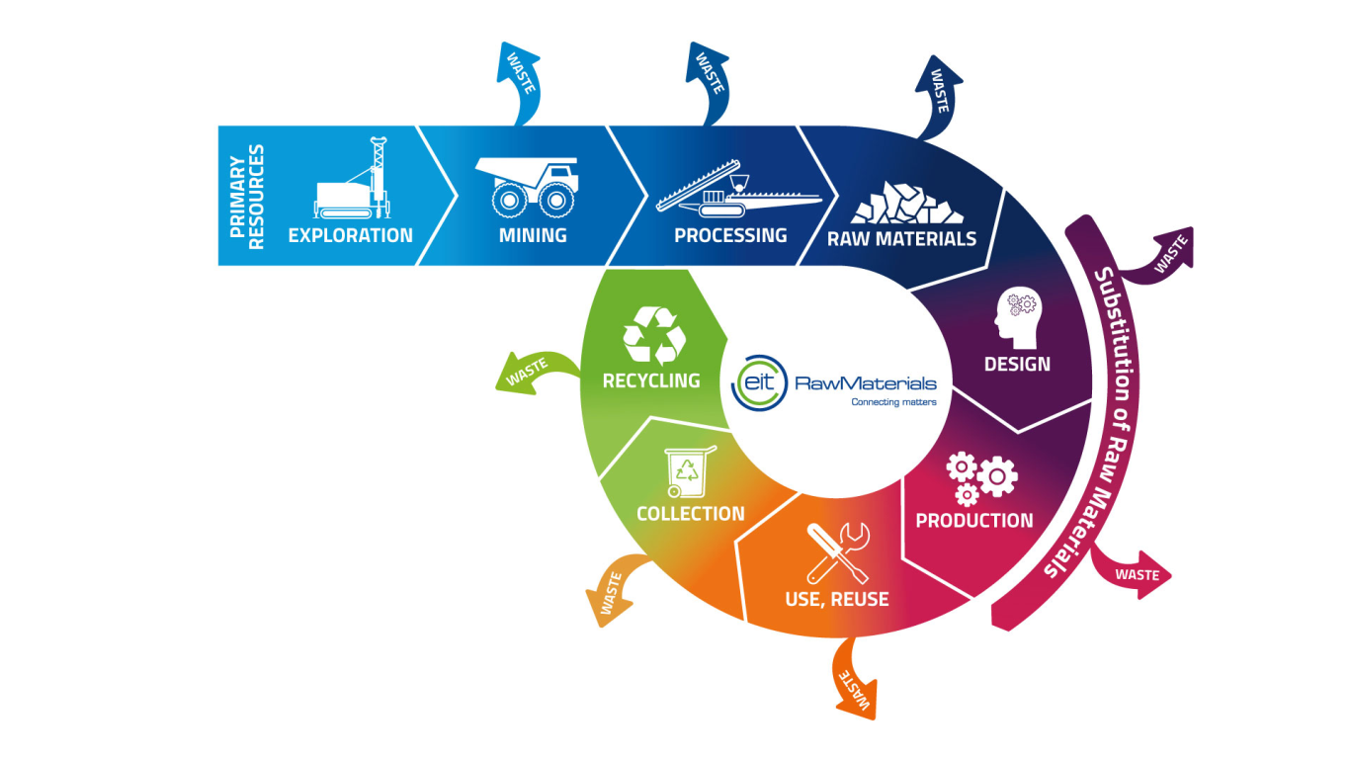



Thank you very much for your attention
Time for your questions
Stricter targets
We should not circulate POPs -
But we should also avoid to generate more waste and use more resources than necessary

Slide 11
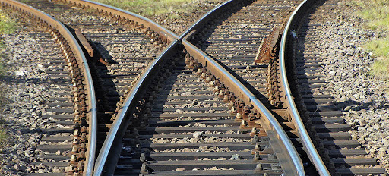
Sources for fotos
Balance: styf – Fotolia.com: here https://www.shz.de/lokales/landeszeitung/die-richtige-balance-im-leben-finden-id8580336.html
Square of the circle – wikipedia: https://de.wikipedia.org/wiki/Quadratur_des_Kreises#/media/Datei:Squaring_the_circle.svg
Square as a wheel in a bicycle: xing: https://www.xing.com/news/insiders/articles/geschaftsorientierte-it-die-quadratur-des-kreises-1642325
Less is more: https://pretzelandscones.com/?p=214

