Slide 1
The SCIP Database: Towards “Clean” Cycles
FEAD - Waste Management: Combining the Circular Economy with the Zero-Pollution Ambition
1 June 2021
Lorenzo MAROTTI
Exposure and Supply Chain Unit
European Chemicals Agency

Slide 2


The European Chemicals Agency
“We, together with our partners, work for the safe use of chemicals.”

Slide 3
The SCIP Database
What is the SCIP Database? What are its Objectives?

Slide 4


The SCIP Database
SCIP is the database for information on Substances of Concern In articles as such or in complex objects (Products) established under the Waste Framework Directive (WFD).
The SCIP database aims to increase the knowledge of hazardous chemicals in articles and products throughout their whole lifecycle - including at the waste stage.

Slide 5
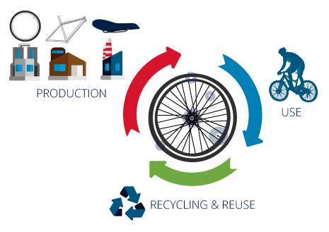
General Objectives
The SCIP database provides information on articles containing Candidate List Substances and makes it available throughout the whole lifecycle of products and materials, including at the waste stage.
Encourage substitution of those substances with safer alternatives
Track and reduce hazardous substances in waste
Contribute to a “clean” circular economy by ensuring that hazardous substances are not present in recycled materials.

Slide 6
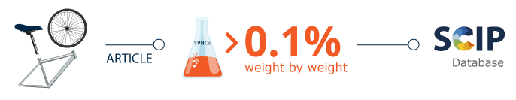
SCIP Obligation
Companies supplying articles containing substances of very high concern (SVHCs) on the Candidate List in a concentration above 0.1% weight by weight (w/w) on the EU market have to submit information on such articles to ECHA, as from 5 January 2021.

Slide 7



SCIP Target Audience
Waste Operators
Consumers
Authorities
Support Waste Management Practices e.g. Segregation
Innovation
Increased Output Production/Quality of Recyclates
Informed Choice when buying products
More information on how to better Use and Dispose such products
Monitoring SVHCs in Articles/ Materials for Regulatory Actions
Enforcement
Support Policy Making

Slide 8

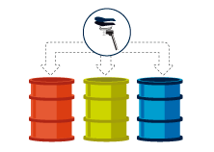
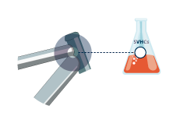

SCIP & Waste Operators
No duties on waste operators! SCIP makes additional data available to Waste Operators to support the improvement of waste management practices and to foster the use of waste as a resource.
Segregation of waste containing Candidate List substances during collection, disassembling, sorting operations…
Identification of material-based streams that could be impacted by SVHCs substances in articles when they become waste
Innovation and emergence of new technology for waste treatment.

Slide 9
Dissemination of SCIP Data

Slide 10
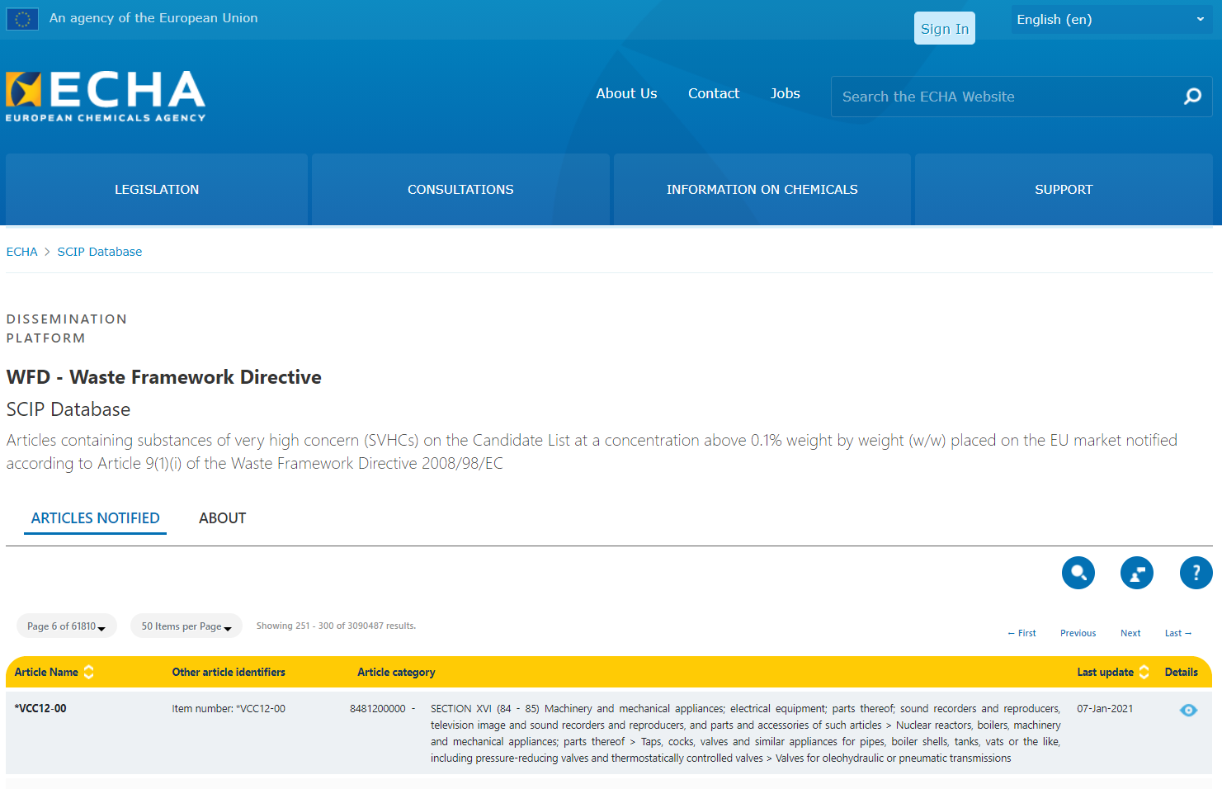
Dissemination of Data
ECHA Dissemination Portal
SCIP Database Search

Slide 11
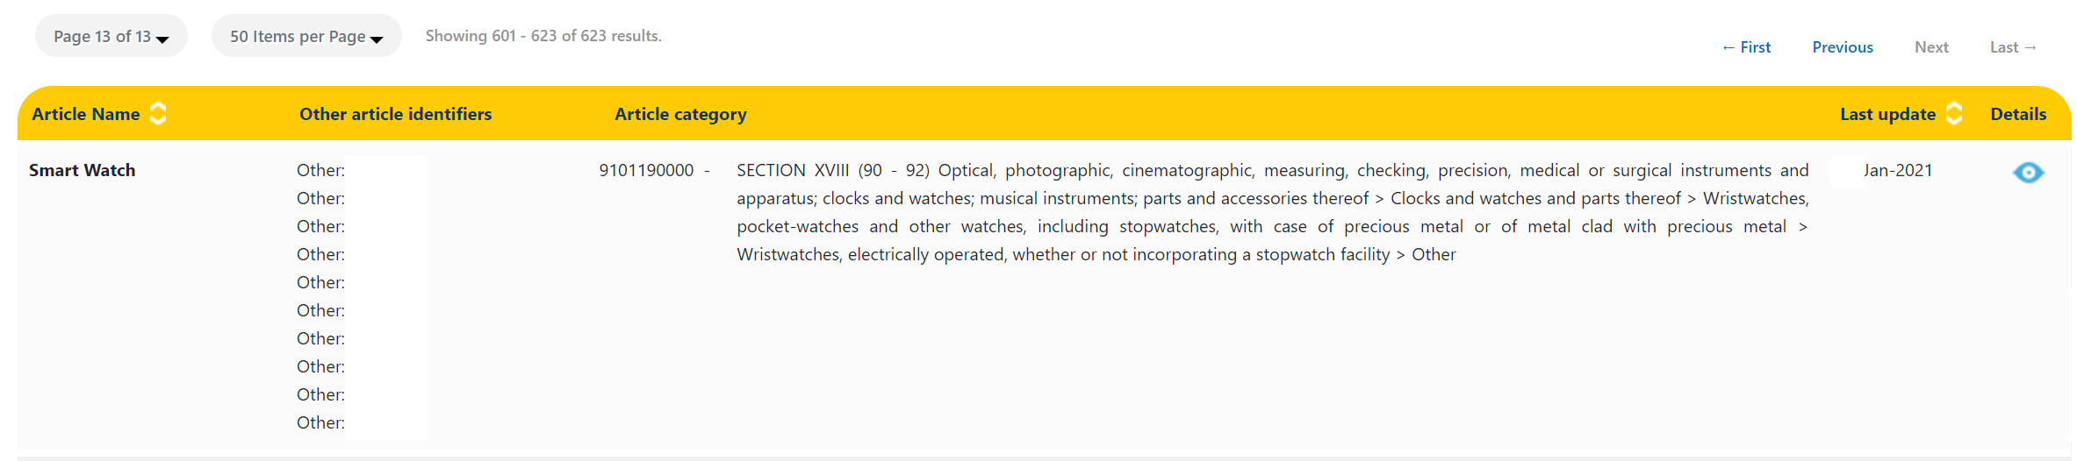
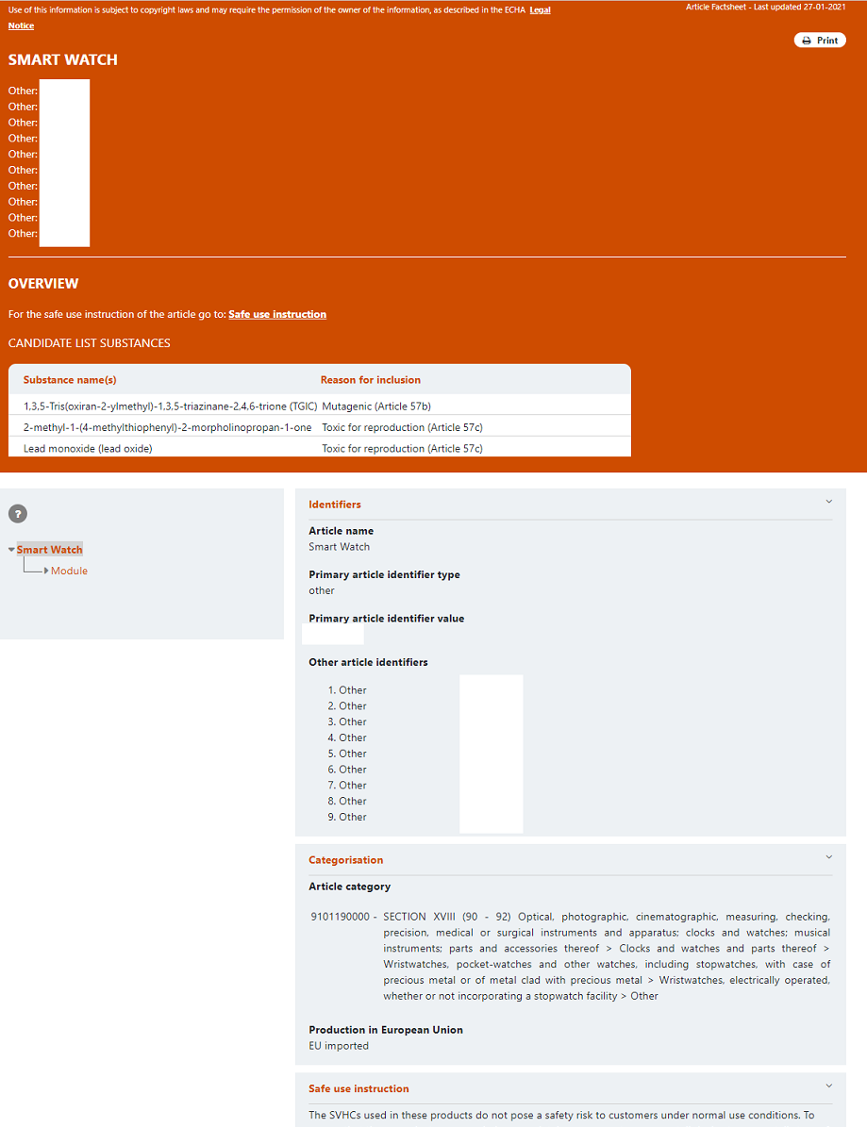
Article/Product
Factsheet

Slide 12
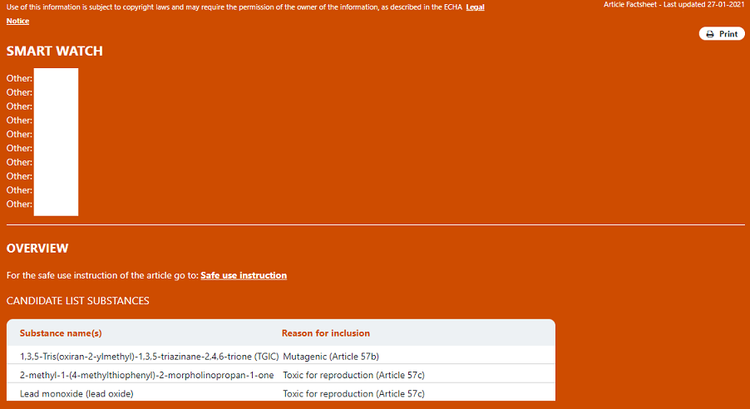
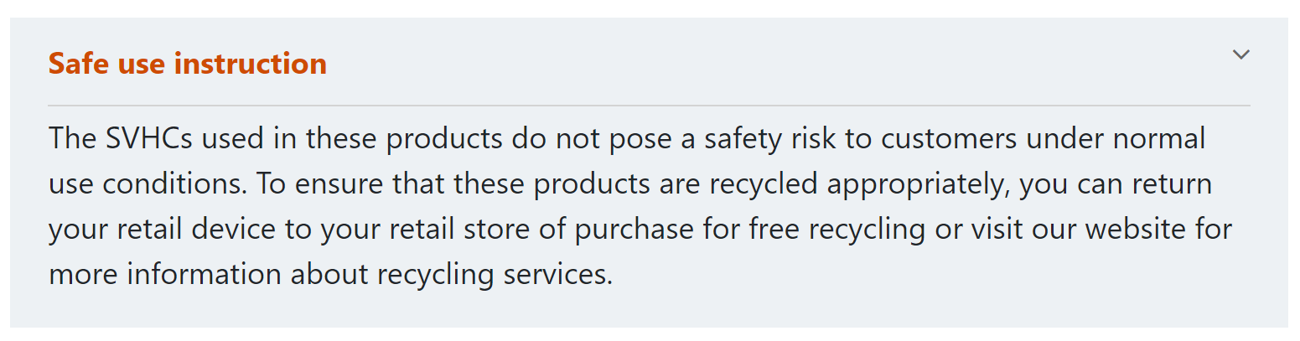
Factsheet: Summary
Article/Product name
Alphanumeric Identifiers
Link to Safe Use Instructions Section

Slide 13
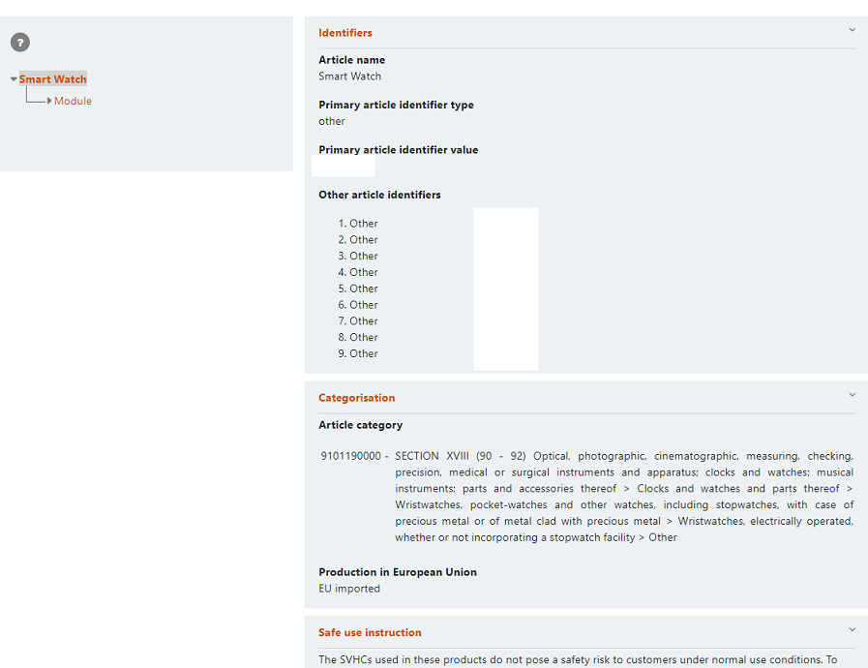
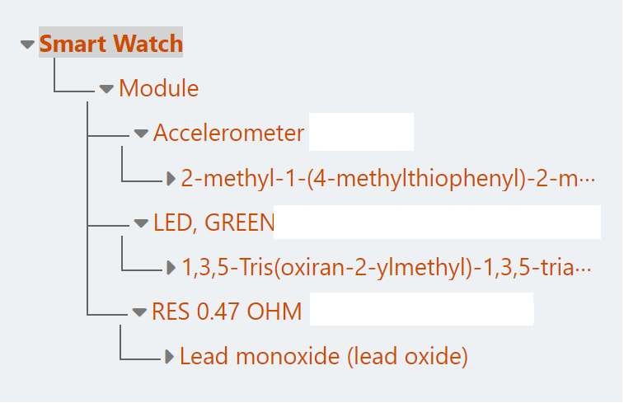

Slide 14
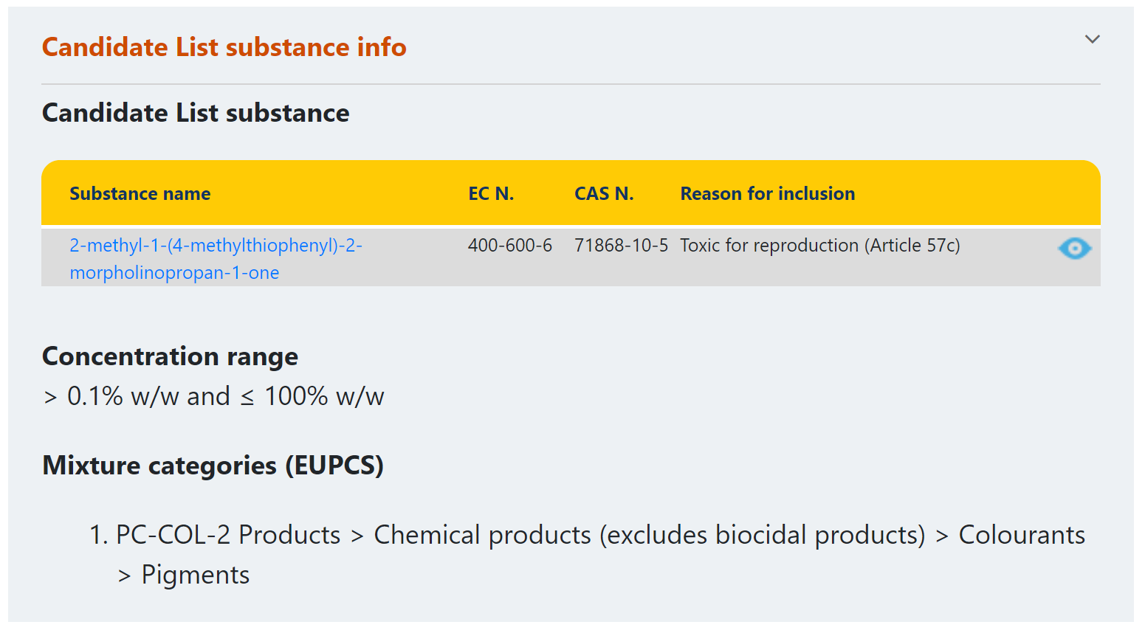
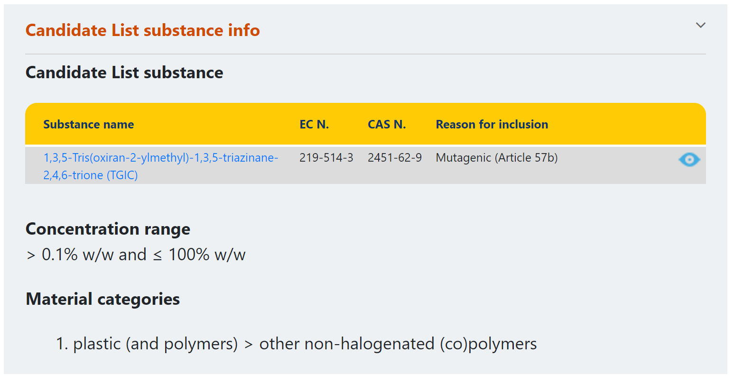

Slide 15
Further Developments
Dissemination currently under construction!
Further Developments:
API (Application Programming Interface): applicable to all data disseminated by ECHA, not only to SCIP
Development and implementation dependant of resources available in coming years.

Slide 16
lorenzo.marotti@echa.europa.eu
scip@echa.europa.eu

Slide 17

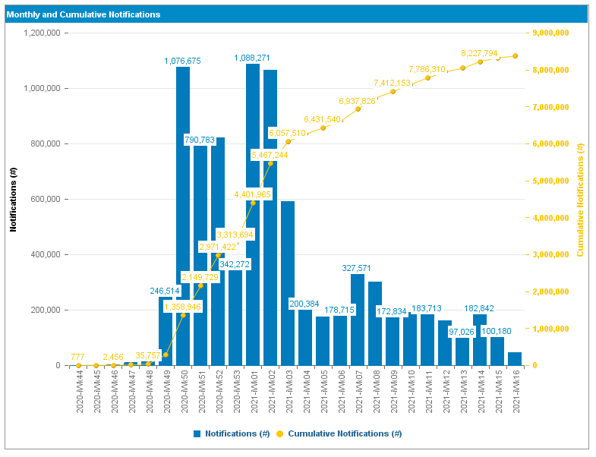
SCIP Notifications
Time period: 28.10.2020 – 21.04.2021
Number of Notifications received:
Approaching 9 millions
(> 12 million submissions: successful, unsuccessful and updates)
Around 4000 companies

Slide 18
Dissemination of SCIP Data
Dissemination
2021
2022
Dissemination of SCIP data
(?)
March 2021: Communication on the delay in the dissemination of SCIP Data on ECHA’s website: unexpected technical issues.

