Slide 1
Waste Management: combining the circular economy with the zero-pollution ambition
European Green Week – 1st June 2021
Luis Carretero – Legal and policy officer
Unit B.2 Sustainable Chemicals – DG Environment

Slide 2
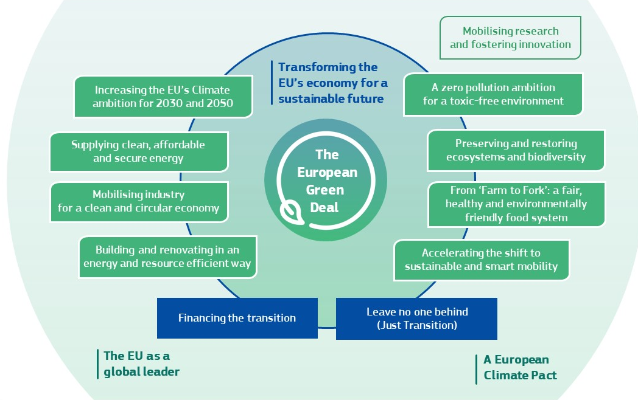
The European Green Deal
Chemicals Strategy
Zero Pollution Action Plan
Circular Economy Action Plan
Notes:
The inputs from MS were very detailed and of good quality. Some of them provoked discussions and required further analysis. We have compiled these observations into four topics – or questions.
______
Background info:
Reports done for 26 Member States – not possible for BG and EL (no data)
21 Member States sent feedback= AT, BE, CY, CZ, DE, DK, ES, HR, HU, IE, IT, LT, LU, LV, NL, PL, PT, RO, SI, SK, UK

Slide 3
Actions with impact on waste management
Revision of product-related legislation:
Eco-design directive (Sustainable Products Initiative)
Green claims initiative
REACH Regulation
CLP Regulation
Other chemical-related pieces of legislation
Revision of waste legislation:
Batteries Regulation (proposal already adopted)
Waste Framework Directive
RoHS Directive
WEEE Directive
ELV Directive
Packaging and Packaging Waste Directive
Waste Shipment Regulation
POPs Regulation (waste annexes)
Non-legislative actions:
Increased investments in innovative technologies to address the presence of legacy substances in waste streams, which could in turn allow to recycle more waste. …
Support technologies such as chemical recycling if they ensure an overall positive environmental and climate performance, from a full life cycle perspective.
Support the development of solutions for high-quality sorting and removing contaminants from waste, including those resulting from incidental contamination.

